Slide 1
Data Modeling for Portuguese Bank
TEAM SUPERNOVA
3rd Oct 2022

Slide 2

THE DM-CRISP
FRAMEWORK

Slide 3
THE DM-CRISP
FRAMEWORK
01
02
03
04
BUSINESS UNDERSTANDING
DATA UNDERSTANDING
MODELING,
EVALUATION &
DEPLOYMENT
DATA
PREPARATION
- Define Business Problem
- Business Background
- How can DS can be useful ?
- Understanding the Dataset
- Identifying Key Features
& Target Variable
- Exploratory Data Analysis
- Data Transformation/Cleaning
- Data Leakage
- Feature Engineering
- Modeling
- Modeling Optimization
- Performance Evaluation
- Model Deployment
- Cost Benefit Matrix,
Correlation Matrix
& Expected Value

Slide 4
01
BUSINESS
UNDERSTANDING

Slide 5
Business Problem
Business Problem
There has been a revenue decline for the Portuguese bank and they would like to know what actions to take. After investigation, we found out that the root cause is that their clients are not depositing as frequently as before.
Solution
To promote Term deposits as a product & the bank can invest in higher gain financial products to make a profit.
Identify customers with high propensity to subscribe to a term deposit within a stipulated time frame and focus marketing efforts on them.
Business Background
Portuguese bank is a well- known bank which accepts checking, savings deposits, term deposits and makes loans.
Offers variety of services such as credit cards, home and auto loans, etc.
The primary objective of the bank at present is managing the spread between deposits and the loans and maximize deposits to increase profits.
The bank realizes profit from lending part of the deposits towards consumer/B2B loans as well as from investing the funds in various markets.

Slide 6
Business Understanding
By utilizing supervised learning for predictive analysis on customer behavior, we plan to build a model for the bank which would help them identify which potential customers are more likely to get onboard with them.
Data scientists can utilize data from previous campaign to construct algorithms & make
prediction.
Highly targeted campaigns which would lead to a boost in customer acquisition at
lower costs

Slide 7
02
Data Understanding

Slide 8
Understanding the Dataset
The Bank Marketing dataset
Related to direct marketing campaigns (phone calls) of a Portuguese Bank
40K+ records
Exploring the dataset in various ways:
Check null values (0), missing values (0) and duplicate rows (0)
Unstandardized values in the dataset, mix of data types
Summary Statistics
Correlation heatmaps
Draw bar graphs for each attributes
Source: UCI Machine Learning Library

Slide 9
Key Features and Target Variable
Our target variable:
Term Deposit (Binary: Yes,No)
Our key features were:
Job - Client’s occupation
Marital status - Client’s marital status
Education - Client’s education level
Default - Indicates if the client has credit in default
Loan(personal) - Does the client have a personal loan?
We had some features that were right skewed such as:
Housing - Does the client have a housing loan?
Marital
Target

Slide 10
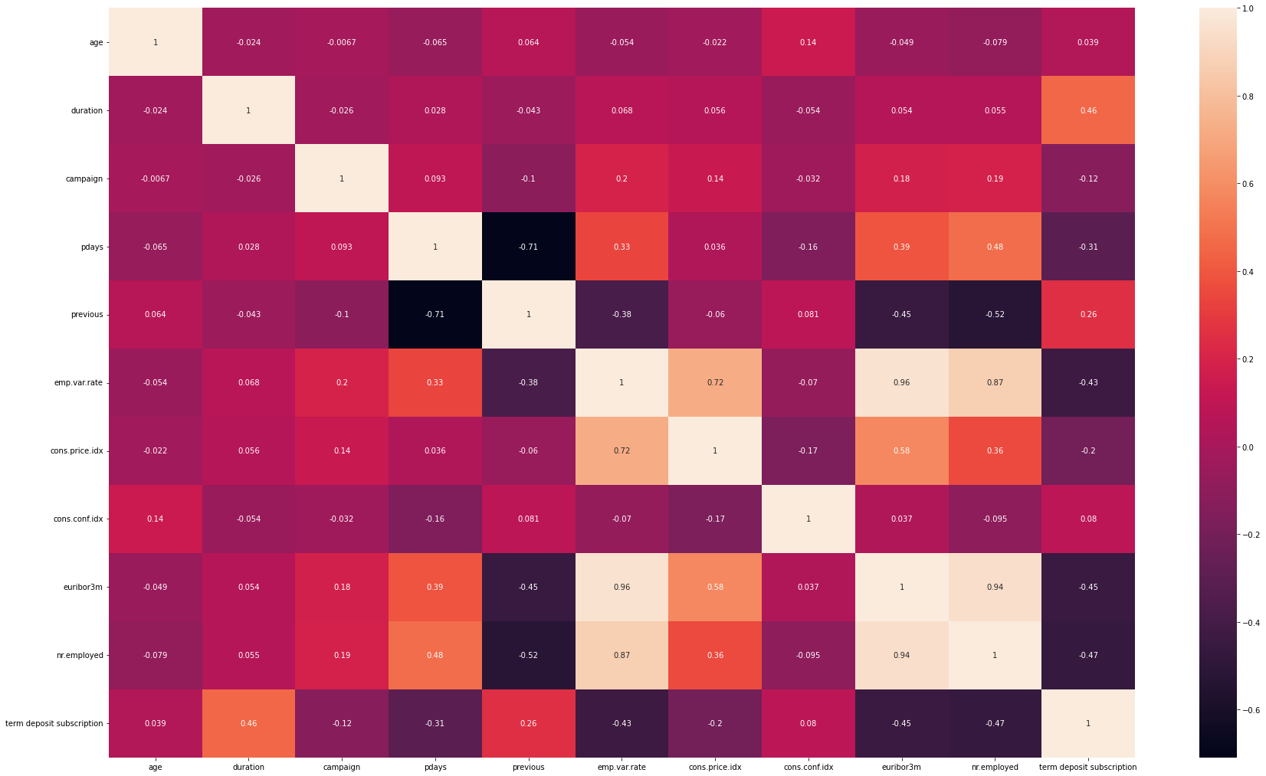
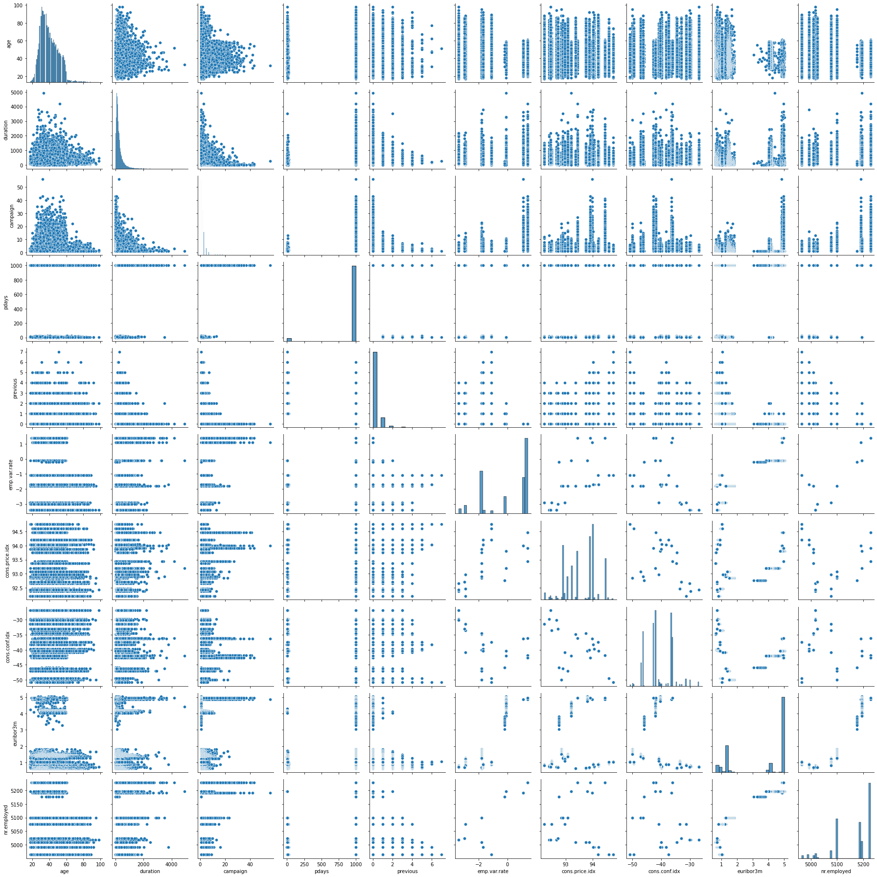
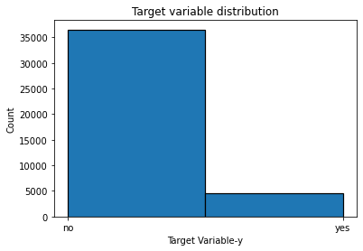
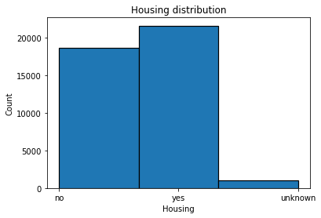
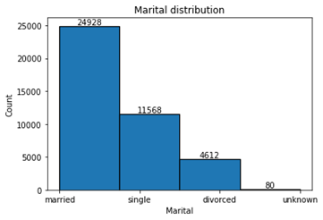
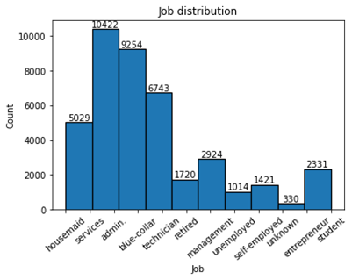
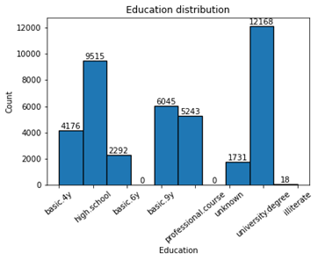
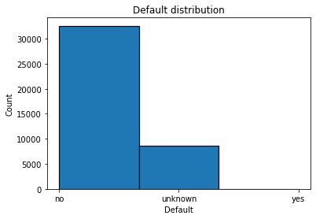
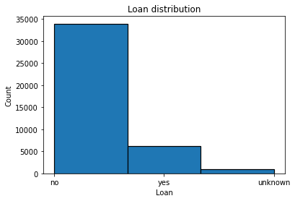
Exploratory Data Analysis

Slide 11
Exploratory Data Analysis
Our target variable was imbalanced with
-Yes: 36548 -No: 4640
Correlation matrix:
-Emp.var.rate, term deposit subscription, euribor3m, and nr.employed are strongly correlated to target columns
Source: Ellering, Nathan “How Often to Post on Social Media?” CoSchedule.com. 18 October 2017.
Source: Arens, Elizabeth "The best times to post on social media in 2020.” SproutSocial.com. 10 March 2020.

Slide 12
03
DATA PREPARATION

Slide 13

DATA LEAKAGE
WHAT IS DATA LEAKAGE?
DO WE HAVE ANY ATTRIBUTES WHICH CAN LEAD TO
DATA LEAKAGE?
Data Leakage refers to the phenomenon where we have some features in our dataset that aren’t available to us at the moment of prediction but will be available to us in the future. Such features shouldn’t be used for predictive modeling.
Why no ads?
Past Campaign
Ended
Current Campaign
Just Ended
Future Campaign
To start
We don’t have any attributes that can contribute to data leakage as we have all information related to our clients, socio-economic features and past campaign. Our current campaign ended some time back and we have all the information for that. All the features are known to us for predictions for the future campaign.

Slide 14

FEATURE ENGINEERING
WHAT IS FEATURE ENGINEERING?
OUR NEW FEATURE
Feature Engineering refers to the manipulation of the dataset to improve the performance of our ML models. We can do this by creating new variables which we did in our project.
Why no ads?
We created a new feature:- (quarterly change of employment numbers). We got this feature by multiplying the emp.var.rate by the nr.employed which indicates the change in employment and evaluated its performance. This also led to less multi-collinearity among the two features in our dataset.

Slide 15
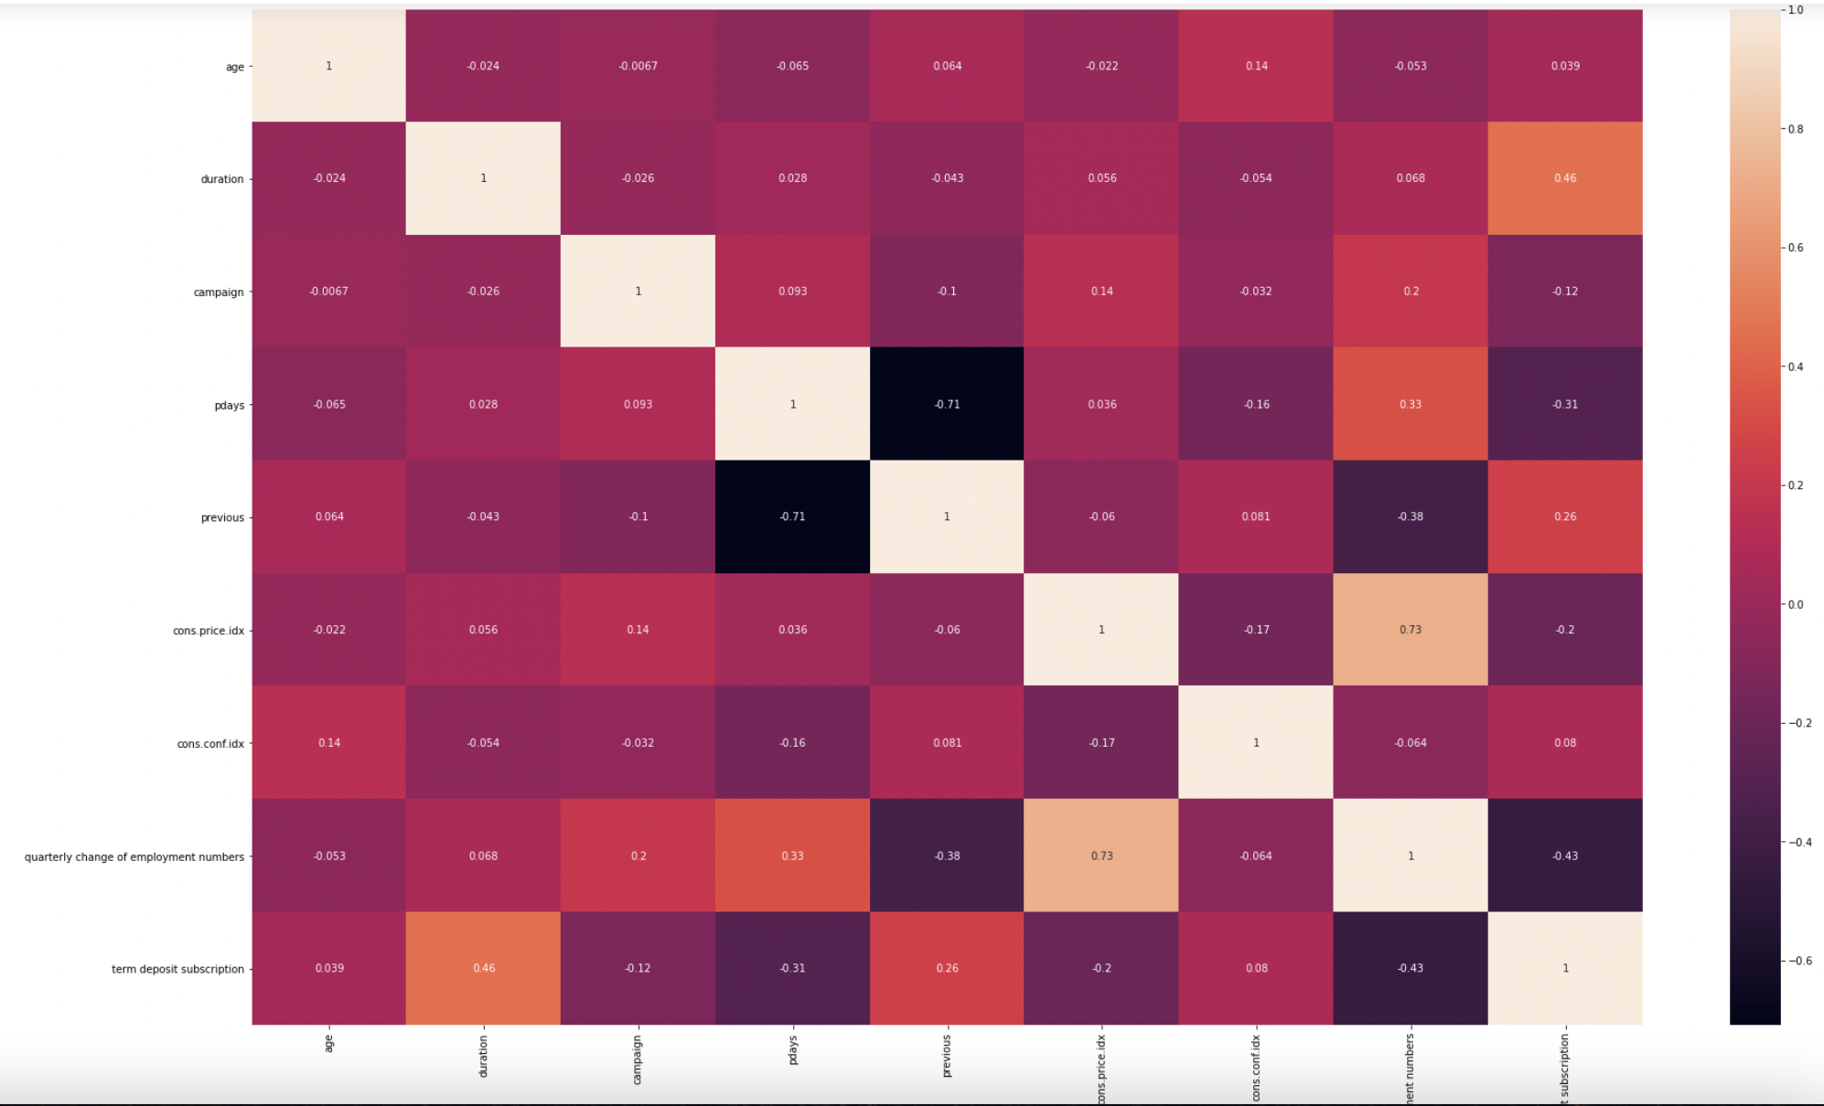
FEATURE ENGINEERING
Before Feature Engineering
After Feature Engineering
Why no ads?

Slide 16

DATA CLEANING
Standardize Record Values
We converted all record types (un-standardized values) to standardized values.
Convert Data Types
We changed the data types of some of our attributes to ensure clean data values in our columns.

Slide 17
DATA TRANSFORMATION
Creating Dummy Variables
Handling Imbalanced Dataset
We created dummy variables in order to change our categorical variables to binary form. As a result, our columns changed from 21 to 64.
We managed the imbalanced data set by oversampling method i.e. we duplicated records from the minority class and added them to our data set to maintain an equal number of target classes.
Feature Engineering
Feature Selection
We introduced a new feature in our model (quarterly change of employment numbers) by multiplying the emp.var.rate by the nr.employed which indicates the change in employment and evaluated its performance.
We removed the variable -euribor3m rate as it had a high correlation (>0.95) with our new feature in the feature-engineered dataset.

Slide 18
04
Modeling, Evaluation, and Deployment

Slide 19
Modeling
Try different models to find the best performing one:
Logistic Regression, k-NN, Decision Tree
Utilize nested cross-validation with hyperparameter search
5 folds in the inner and outer loops
F-1, recall, precision scoring metric
Use a grid search for hyperparameter tuning
Perform additional data preparation for the k-NN model
Standardize numeric & binary features

Slide 20
Model Optimization
 | Logistic Regression | KNN | Decision Tree
Hyperparameter Tuning | Optimal Parameter: {'C': 100,'penalty': 'l1'} | Optimal Parameter: {'n_neighbors': 2, 'weights': 'distance'} |  | Optimal Parameter: {'criterion': 'gini', 'max_depth': 9}
Feature Importance Criteria | Odds | N/A |  | Decrease in Node Impurity
Important Features | Marital_married, Marital_single, Contact_cellular, Day of week_mon | N/A |  | Quarterly Change of Employment Numbers, Cons.conf.idx, Month_may, Month_oct

Slide 21
Models Comparison (Nested Cross-Validation Scores)
 | Before Feature Eng. |  |  | After Feature Eng.
Models | F1-Score | Recall | Precision | F1-Score | Recall | Precision
Logistic Regression | 0.859 +/- 0.003 | 0.861 +/- 0.007 | 0.855 +/- 0.006 | 0.870 +/- 0.001 | 0.882 +/- 0.003 | 0.862 +/- 0.003
K-NN | 0.964 +/- 0.000 | 0.999 +/- 0.000 | 0.935 +/- 0.002 | 0.965 +/- 0.001 | 0.999 +/- 0.000 | 0.935 +/- 0.003
Decision Tree | 0.869 +/- 0.006 | 0.949 +/- 0.006 | 0.802 +/- 0.005 | 0.876 +/- 0.008 | 0.961 +/- 0.011 | 0.800 +/- 0.005

Slide 22
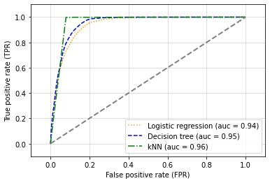
Evaluation
K-NN is the best performing model on all 3 performance metrics
A good F1 score indicates low false positives and low negatives
The higher AUC, the better model predicts whether a customer will subscribe a deposit term in the bank
The K-NN with nested-cross validation is the best model, but it is not easy to understand like the decision tree
Models | F1-Score |  |  | AUC
Logistic Regression | 0.870 +/- 0.001 |  |  | 0.94
K-NN | 0.965 +/- 0.001 |  |  | 0.96
Decision Tree | 0.876 +/- 0.008 |  |  | 0.95

Slide 23
COST BENEFIT MATRIX,CONFUSION MATRIX AND EXPECTED VALUE
Normalized Cost-Benefit Matrix
Confusion Matrix (for k-NN optimized parameters)
Expected Value: (85)*(46.14%)+(-5)*( 4.04%)+0+0=39.017
 | Actual Positive | Actual Negative
Predicted Positive | 85 | -5
Predicted Negative | 0 | 0
 | Actual Positive | Actual Negative
Predicted Positive | 10119 (46.14%) | 886 (4.04%)
Predicted Negative | 25 (0.11%) | 10899 (49.70%)

Slide 24

MODEL DEPLOYMENT
Utilization of the Model
The model can be useful in determining which customers would most likely subscribe to our Term Deposit service. This will be really helpful to accordingly target customers in future marketing campaigns.
The Bank can apply this model to:
Develop more targeted marketing campaigns
Position the product by user profiles
Determine the demand for Term Deposits & align resources accordingly
Determine feasibility & scope for future campaigns
Upsell other services to high-propensity customers

Slide 25
QUESTIONS?
THANK YOU.

Slide 26
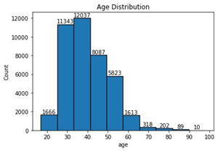
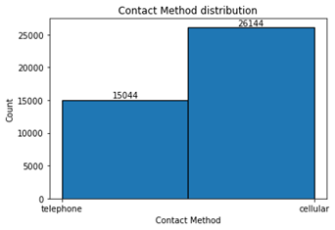
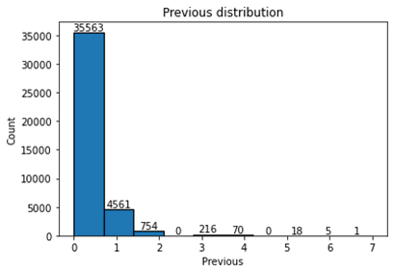
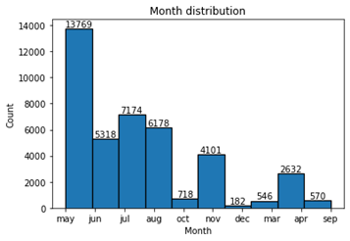
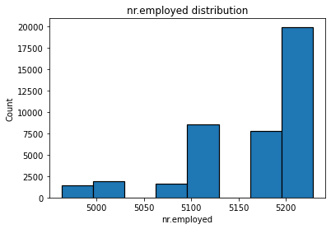
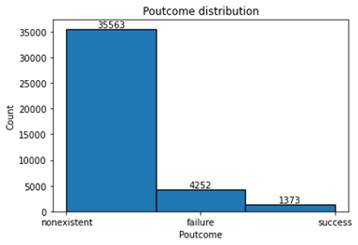
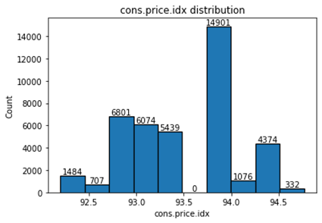
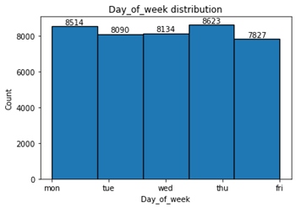
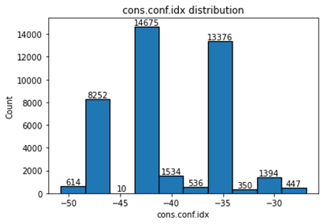
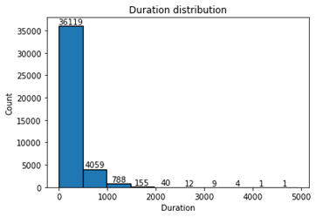

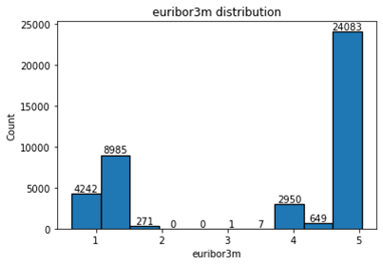
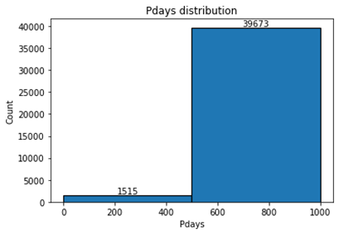
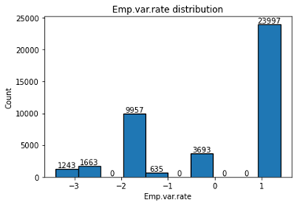
Appendix

Slide 27
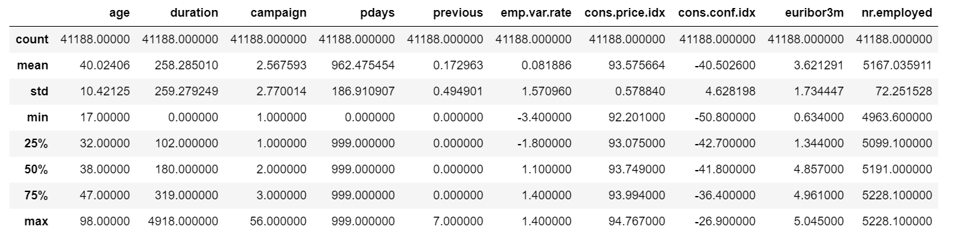
Appendix

